Slide 1
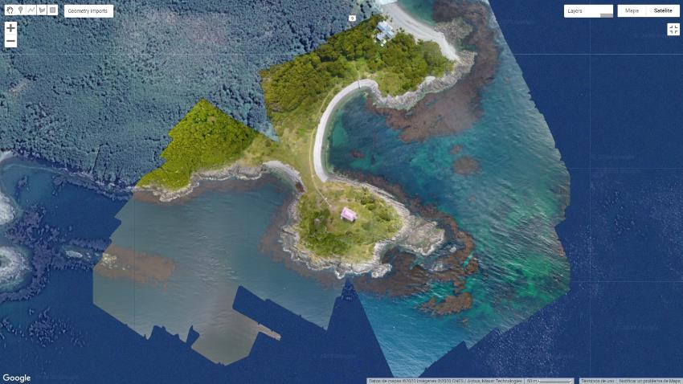
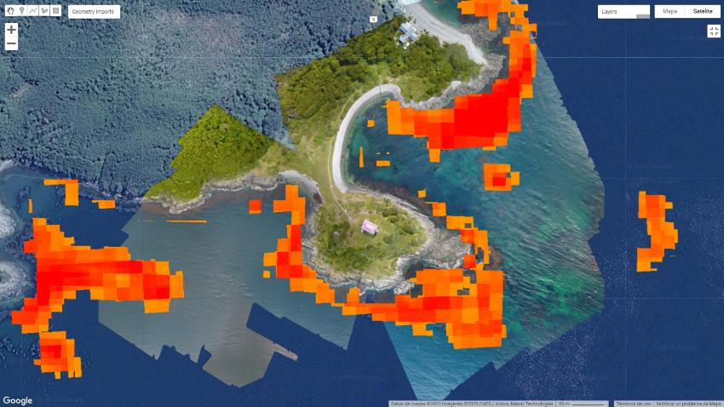
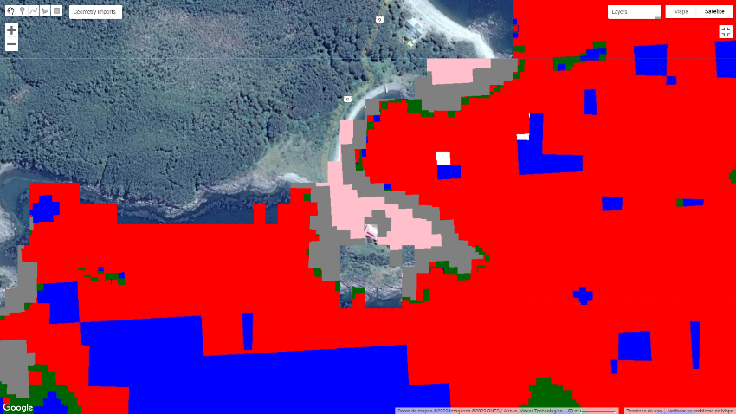
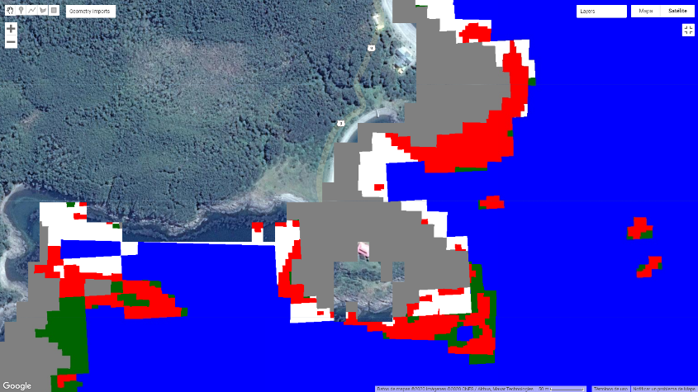
Original Drone image: San Isidro
KD Algorithm
Kelp
Random Forest
CART
Kelp
Ocean
Coast
Symbology RF and CART:
Green Algae
Land veg
Foam

Slide 2
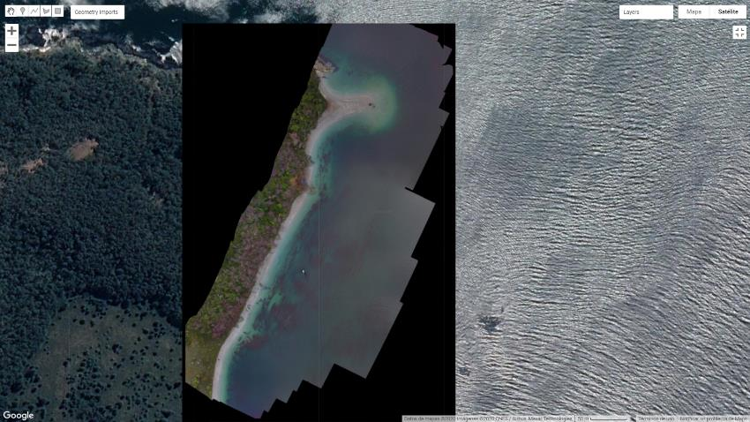
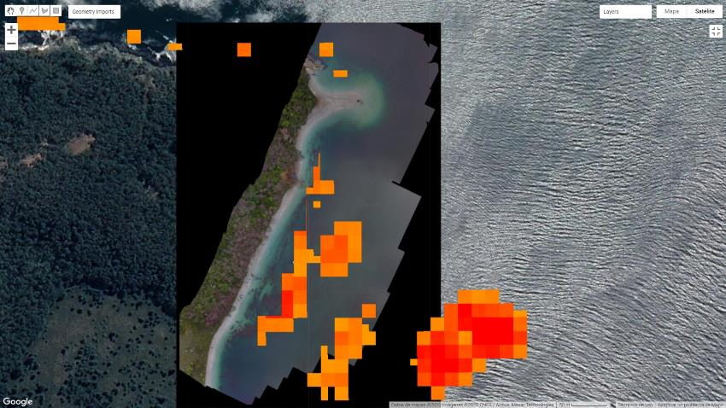
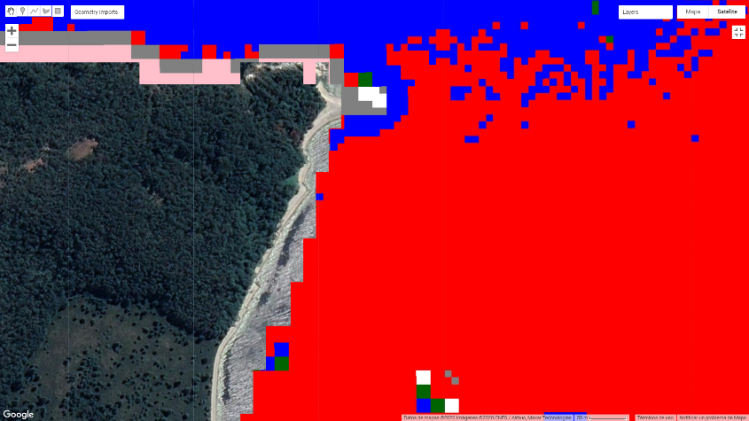
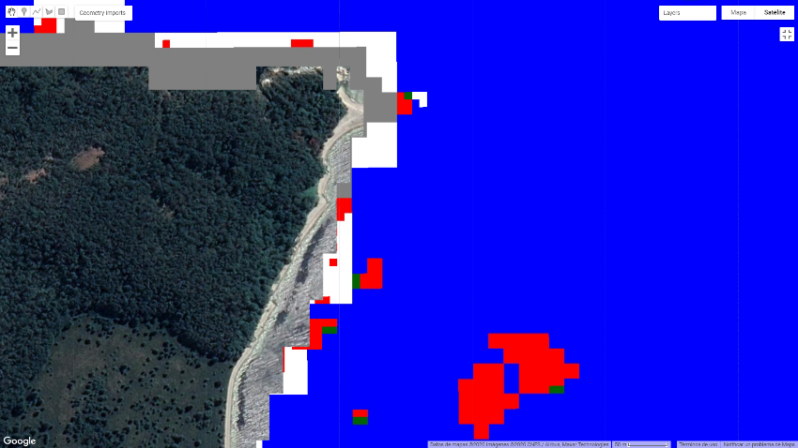
KD Algorithm
Original Drone image: Yendegaia
Kelp
Random Forest
CART
Kelp
Ocean
Coast
Symbology RF and CART:
Green Algae
Land veg
Foam

Slide 3
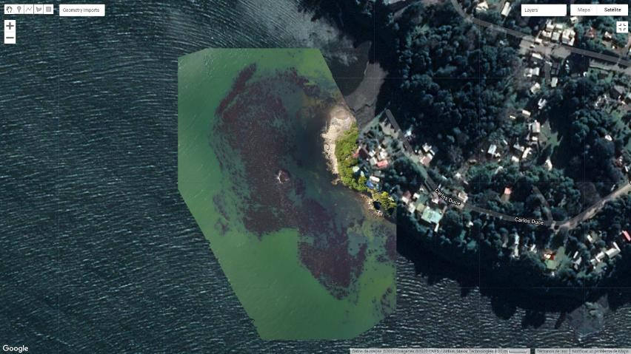
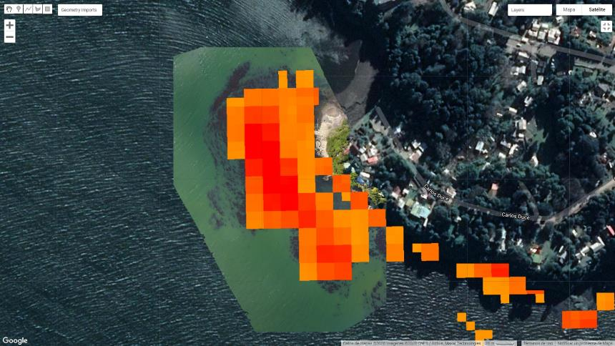
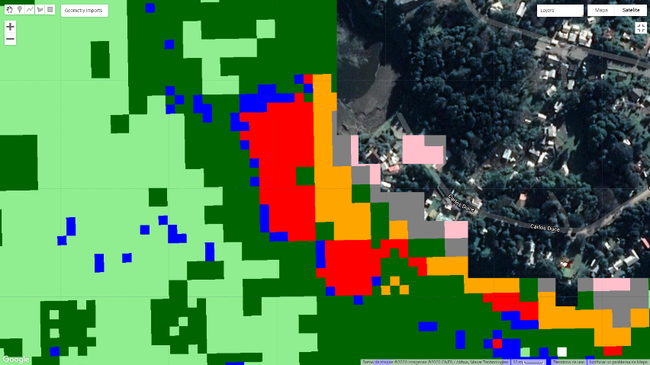
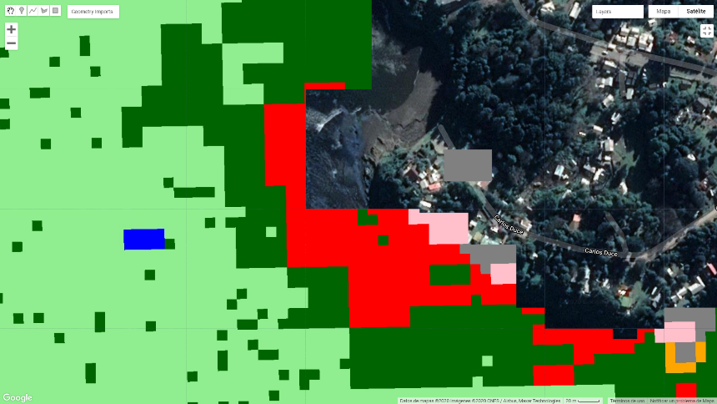
Original Drone image: Niebla
KD Algorithm
Kelp
Random Forest
CART
Kelp
Ocean
Coast
Organic water
Symbology RF and CART:
Green Algae
Land veg
Foam
River Grass

Slide 4
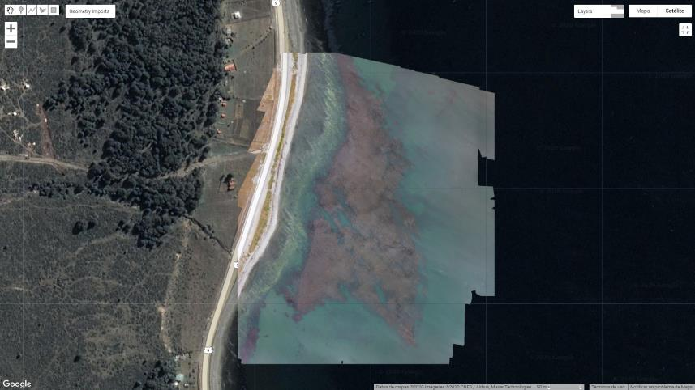
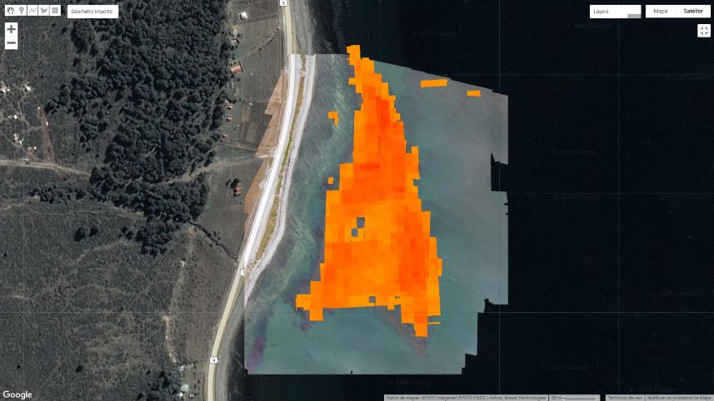
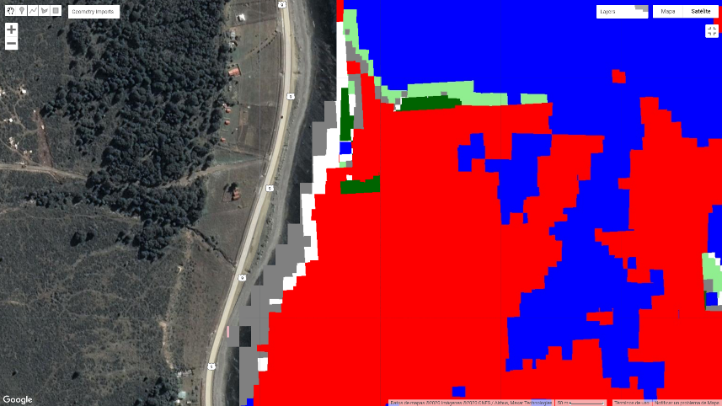
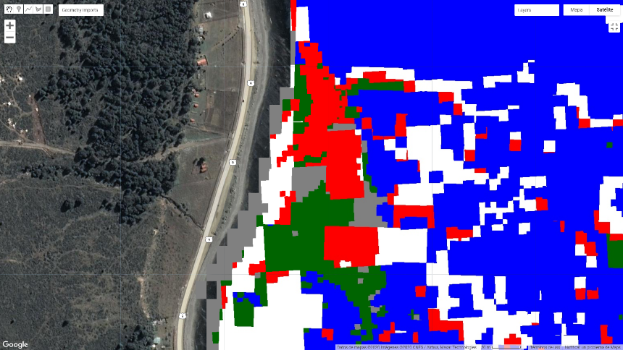
Original Drone image: Punta Carrera
KD Algorithm
Kelp
Random Forest
CART
Kelp
Ocean
Coast
Organic water
Symbology RF and CART:
Green Algae
Land veg
Foam
River Grass

Slide 5
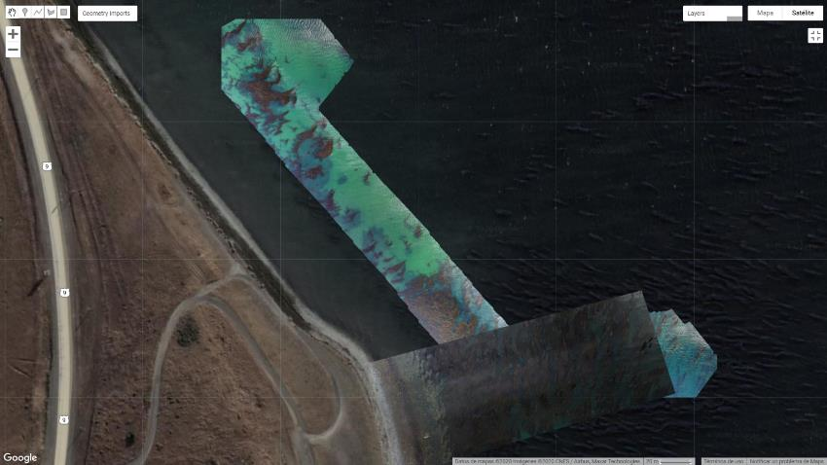
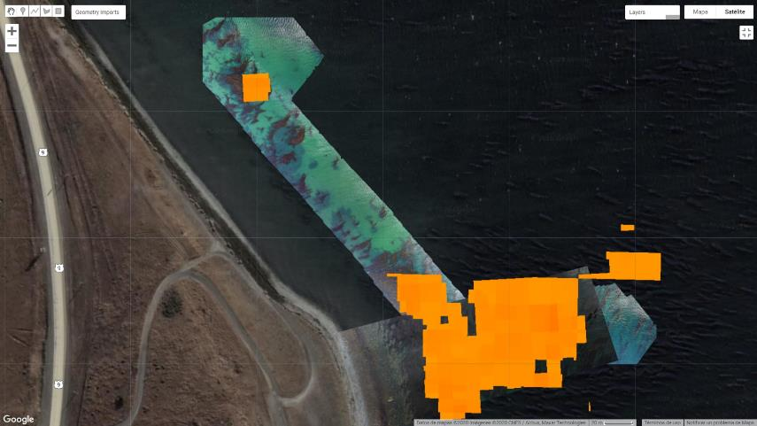
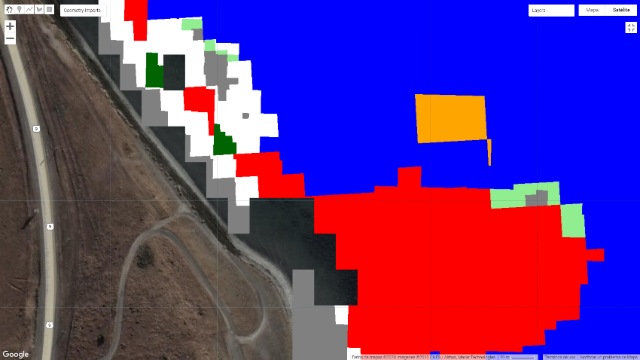
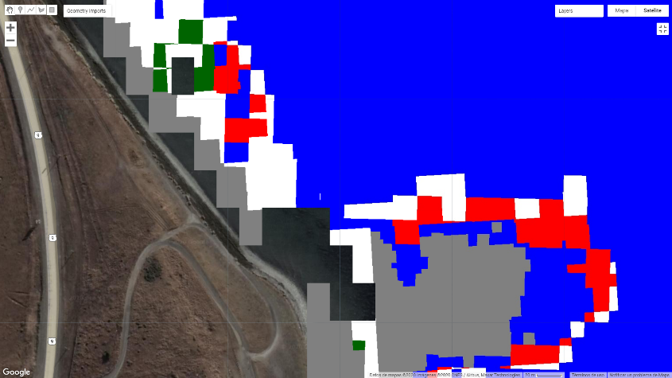
Original Drone image: Chabunco
KD Algorithm
Kelp
CART
Random Forest
Kelp
Ocean
Coast
Organic water
Symbology RF and CART:
Green Algae
Land veg
Foam
River Grass

